Slide 1
WEEK 2

Slide 2
TOPICS TO BE COVERED
Wrapper classes (Integer, Double, Character, etc.)
Autoboxing and Unboxing
Enumeration (enum)
Enum methods and constructors

Slide 3
WRAPPER CLASS
A Wrapper class in Java is one whose object wraps or contains primitive data types.
When we create an object in a wrapper class, it contains a field and, in this field, we can store primitive data types.
In other words, we can wrap a primitive value into a wrapper class object.

Slide 4
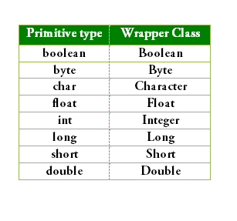
WRAPPER CLASS

Slide 5
Need for WRAPPER CLASS
They convert primitive data types into objects. Objects are needed if we wish to modify the arguments passed into a method (because primitive types are passed by value).
The classes in java.util package handle only objects and hence wrapper classes help in this case.
Data structures in the Collection framework, such as ArrayList and Vector, store only objects (reference types) and not primitive types.
An object is needed to support synchronization in multithreading.

Slide 6
class wrapperDemo
{
public static void main(String[] args)
{
// Primitive data type
int b;
// Integer wrapper class
Integer a;
// assigning value to primitive
b = 357;
// auto-boxing or auto wrapping converting primitive int to Integer object
a = b;
System.out.println("The primitive int b is: " + b);
System.out.println("The Integer object a is: " + a);
}
}
Example
OUTPUT:
The primitive int b is: 357
The Integer object a is: 357

Slide 7
AUTOBOXING AND UNBOXING
Autoboxing
The automatic conversion of primitive types to the object of their corresponding wrapper classes is known as autoboxing.
For example: conversion of int to Integer, long to Long, double to Double, etc.

Slide 8
AUTOBOXING AND UNBOXING
Unboxing
It is just the reverse process of autoboxing. Automatically converting an object of a wrapper class to its corresponding primitive type is known as unboxing.
For example, conversion of Integer to int, Long to long, Double to double, etc.

Slide 9
public class AutoBoxingUnboxingDemo {
public static void main(String[] args) {
// Autoboxing: primitive to wrapper object
int num = 50;
Integer intObj = num; // Autoboxing
System.out.println("Autoboxing Example:");
System.out.println("Primitive value : " + num);
System.out.println("Wrapper object : " + intObj);
// Unboxing: wrapper object to primitive
Integer obj = 100;
int value = obj; // Unboxing
System.out.println("\nUnboxing Example:");
System.out.println("Wrapper object : " + obj);
System.out.println("Primitive value : " + value);
}
}
Example
OUTPUT
Autoboxing Example:
Primitive value : 50
Wrapper object : 50
Unboxing Example:
Wrapper object : 100
Primitive value : 100

Slide 10
ENUMERATION
In Java, enumerations (enums) are a special type used to define a group of named constants.
Enums help in readability, maintainability, and type safety in programs by assigning meaningful names to integer values.
Mainly useful when we have a small set of possible values for an item like directions, days of week, etc.
Syntax
enum EnumName{
Constant 1, Constant 2, …, Constant n
}

Slide 11
Example
enum TrafficLight {
RED, GREEN, YELLOW
}
public class Test{
public static void main(String[] args){
TrafficLight x = TrafficLight.RED;
System.out.println(x);
}
}
OUTPUT:
RED

Slide 12
Enum with switch Statement
public static void main(String[] args){
Color var_1 = Color.YELLOW;
// Switch case with Enum
switch (var_1) {
case RED:
System.out.println("Red color");
break;
case GREEN:
System.out.println("Green color");
break;
case BLUE:
System.out.println("Blue color");
break;
default:
System.out.println("Other color");
}
}
}
//import java.io.*;
class enumDemo{
// Enum Declared
enum Color {
RED,
GREEN,
BLUE,
YELLOW;
}

Slide 13
Enum methods and constructors
Enums can have constructors and methods, executed separately for each constant
An enum can also have a constructor just like a class.
The constructor is called automatically when the constants are created. You cannot call it yourself.
Here, each constant in the enum has a value (a string) that is set through the constructor

Slide 14
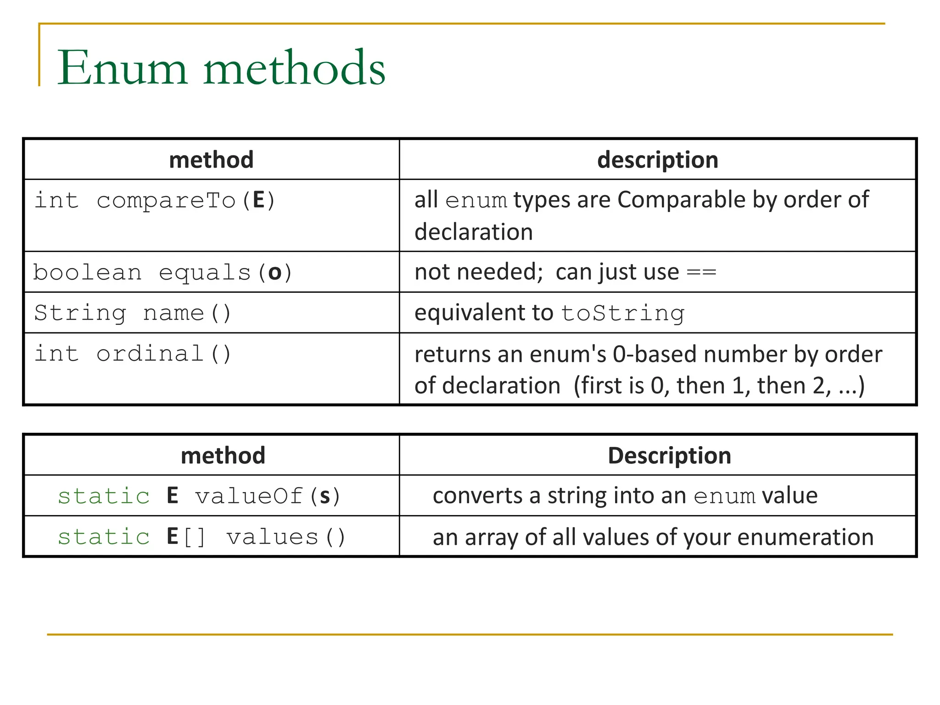
Enumerations methods

Slide 15
enum Color{
RED, GREEN, BLUE;
private Color(){
System.out.println("Constructor called for: " + this);
}
public void display(){
System.out.println("Color is: " + this);
}
}
public class Test{
public static void main(String[] args){
Color c1 = Color.RED;
c1.display();
}
}
Example 1:
OUTPUT
Constructor called for: RED
Constructor called for: GREEN
Constructor called for: BLUE
Color is: RED

Slide 16
// Java program to Illustrate Usage of Enum
// Constructor, Instance Variable & Method
// Enum
enum fruits {
// Attributes associated to enum
Apple(120),
Kiwi(60),
Banana(20),
Orange(80);
// internal data
private int price;
// Constructor
fruits(int pr) { price = pr; }
// Method
int totalPrice() { return price; }
}
Example 2:
// Main class
class Testing {
// main driver method
public static void main(String[] args)
{
// Print statement
System.out.println("Total price of fruits : ");
// Iterating using enhanced for each loop
for (fruits f : fruits.values())
// Print and display the cost and per kg cost of
// fruits
System.out.println(f + " costs “ + f.totalPrice()
+ " rupees per kg.");
}
}

